Slide 1
Raising the Bar: Using CELDT Data to Guide Instructional Decisions for Language Development LD West Elementary EL Designee Meeting February 2016

Slide 2
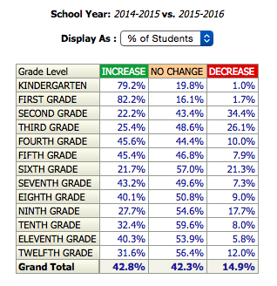
CELDT Data

Slide 3
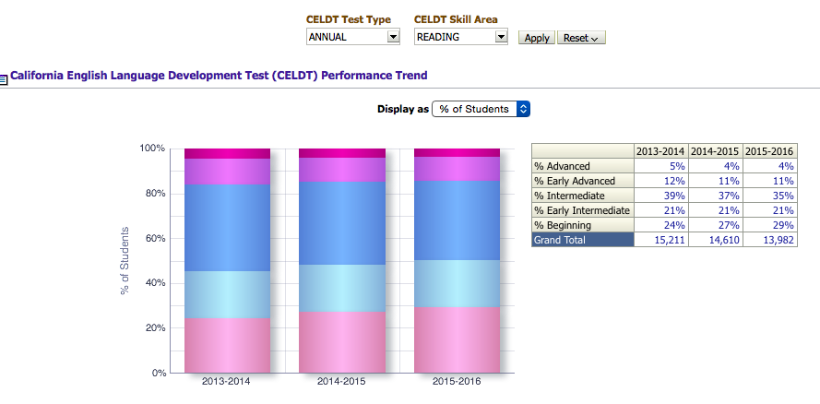
Three-Year Performance Trend Annuals – Reading Domain

Slide 4
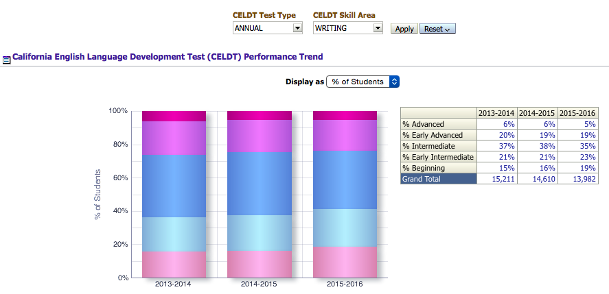
Three-Year Performance Trend Annuals – Writing Domain

Slide 5
Three-Year Performance Trend Annuals – Reading Domain

Slide 6
Three-Year Performance Trend Annuals – Writing Domain

Slide 7
Step 1: CELDT Analysis First My Students…

Slide 8
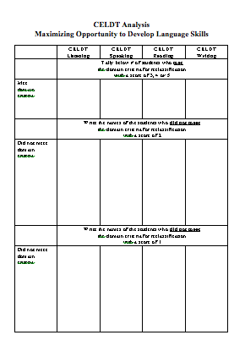
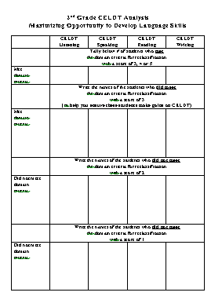
CELDT Analysis

Slide 9
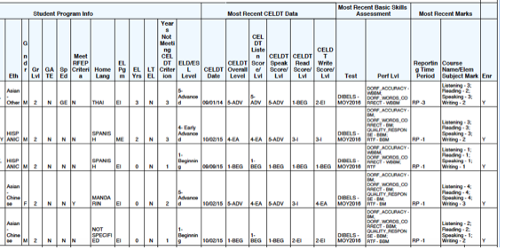
EL Monitoring Roster

Slide 10
CELDT Analysis
First, tally the number of students who met each domain with a score of a 3, 4 or 5.
Next write the names of the students who did not met each domain with the score of a 2 or a 1. For now, just do the reading and writing domain. (If time permits, go back to the listening and speaking domain.)
For 1st, 2nd and 5th grade teachers, knowing that there is enormous drop in the number of students making gains between 1st and 2nd, 2nd and 3rd and 5th and 6th as they grapple with a more difficult assessment, please write down the names of the student who received 3s, especially in reading and writing.
Moises
Moises
Pablo
Zoila
Zoila
Pablo

Slide 11
Step 2: Side-by-Side Grade Level CELDT Analysis

Slide 12
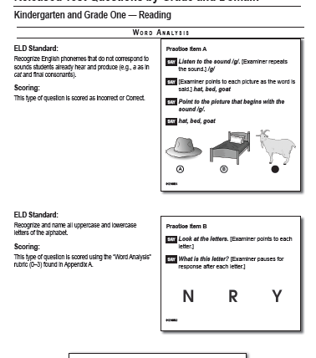
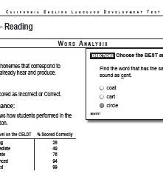
Compare Domain Components Grade Level to Grade Level
1st Grade
2nd Grade

Slide 13
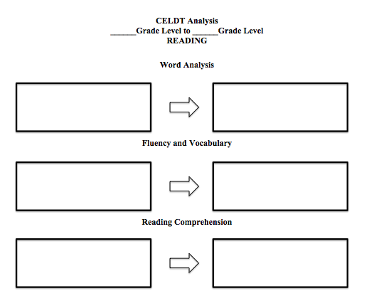
Note Expectations for One Grade Compared to the Next - Reading

Slide 14
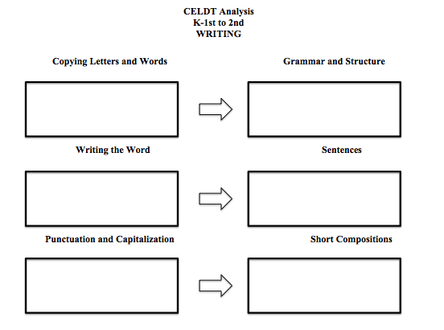
And Writing

Slide 15
Step 3: Maximizing Language Development Opportunities How am I maximizing opportunities all day long and all year long for my students to develop the language skills I know will be assessed on the next grade level’s CELDT? 1st → 2nd 2nd → 3rd 5th → 6th

Slide 16
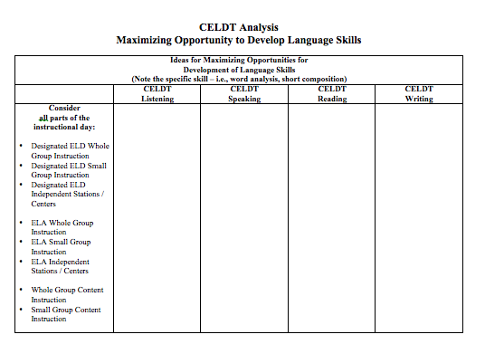
Maximizing Opportunity to Develop Language Skills

Slide 17
Walk and Talk with a Partner
Consider:
what activities/lessons throughout the year you already do to build the skills assessed on the next grade level’s CELDT
what ideas you have regarding what you could do in addition to maximize the opportunity to develop those skills over the course of the instructional day
how Fostering Academic Interactions (Constructive Conversation Skills), Using Complex Text (Deconstructing a Mentor Text during Designated ELD) and Fortifying Complex Output (having student think, speak and write in connected sentences) supports language development
Document your ideas on the posters and on your graphic organizer.

Slide 18
Gallery Walk

